Slide 1






Bilet
Android Application
Design from Kino.kz

Slide 2

01
List of all films and cinemas
List of films in exact cinema with time
Info
02
Possibility to pick places in halls
03
(NOT FINISHED)
04
(other criterias)
05
(other criterias)

Slide 3
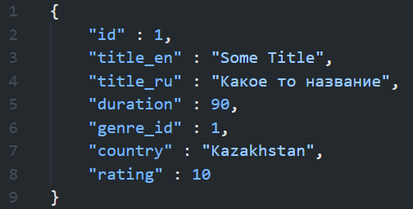
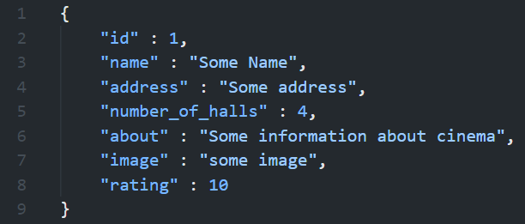
Attributes(Demo)
Simple attributes for films and cinemas.

Slide 4
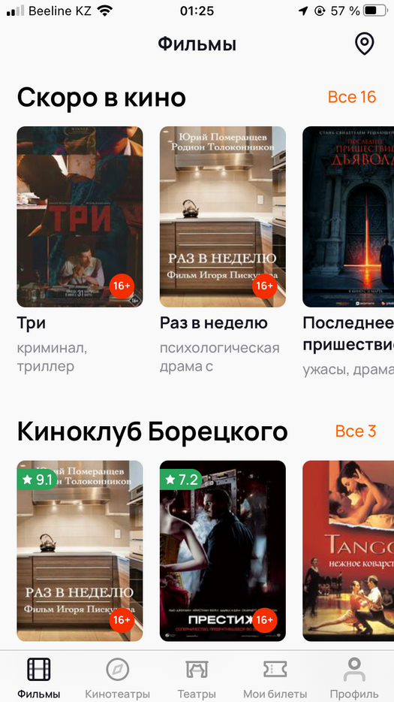
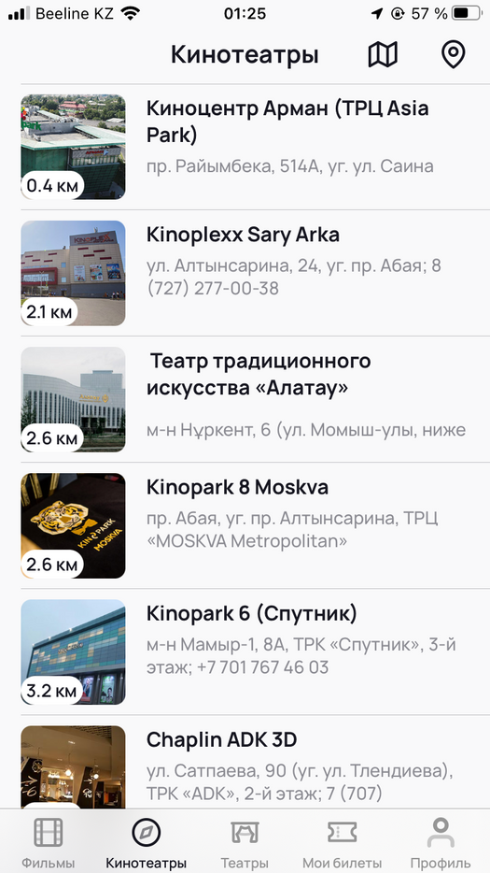
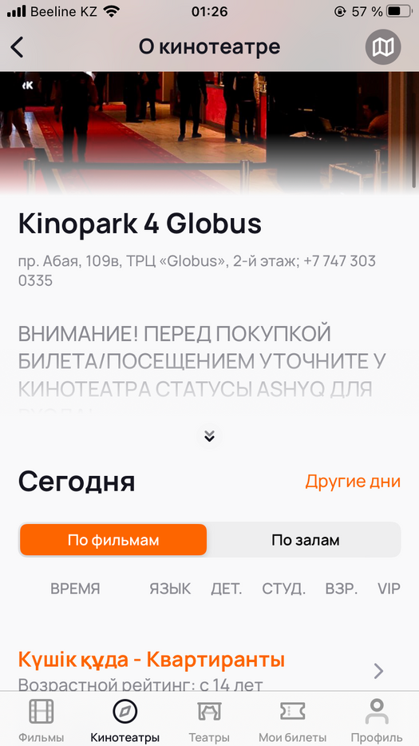
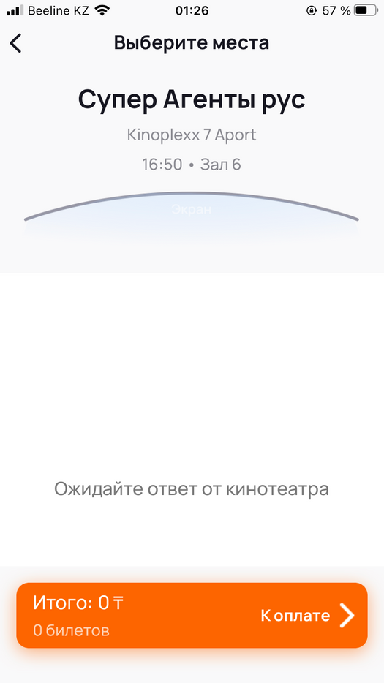
Design from Kino.kz app
Of course, App will have simpler design

Slide 5

That's it, for now.

